Slide 1
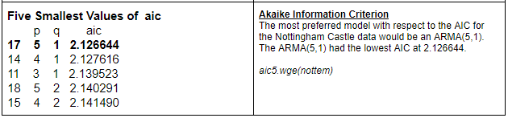
"Unit 5: "For Live Session"
Chad Madding
Use Aic5 to assess the use of ARMA models for your time series. This was added to the Google doc.
AIC On The Nottingham Data

Slide 2
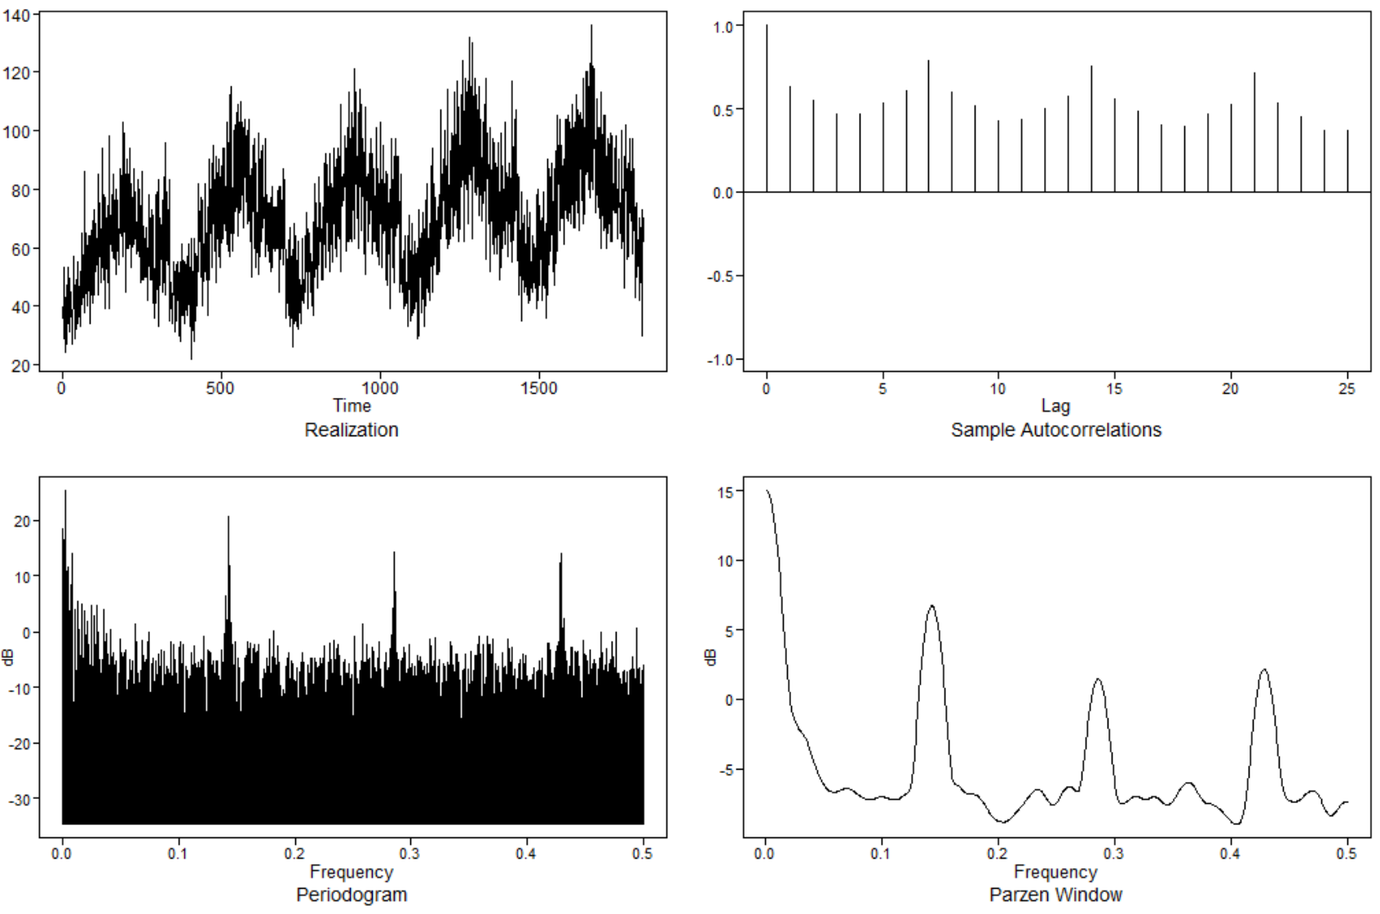
Use Aic5 to assess the use of ARMA models in the Walmart data.
#Find the lowest AIC in the Walmart data
aic5.wge(Store9Item50$sales)
The most preferred model with respect to the AIC for the Wal-Mart store 9 item 50 data is an ARMA(4,2) with an AIC of 4.991650.
Five Smallest Values of aic
p q aic
15 4 2 4.991650
17 5 1 5.009865
18 5 2 5.021469
14 4 1 5.073902
12 3 2 5.114417

Slide 3
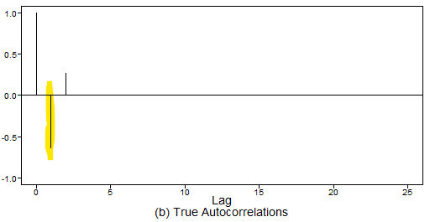

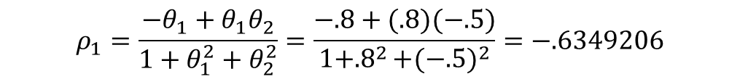
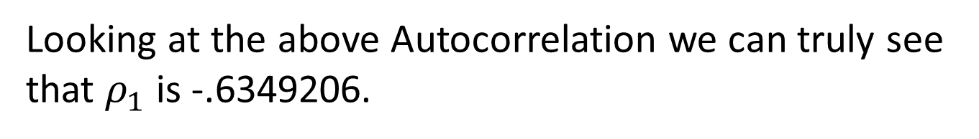
Find $ρ_{1}$ for the following model by hand.
$$X_{t}=a_{t}−.8a_{t−1}+.5a_{t−2}$$
$$ρ_{1}=\frac{−θ_{1}+θ_{1}θ_{2}}{1+θ_{1}^{2}+θ_{2}^{2}}=\frac{−.8+(.8)(−.5)}{1+{.8}^{2}+{(−.5)}^{2}}=−.6349206$$
Check it in R
p1$aut1[2]
[1] -0.6349206
Looking at the above Autocorrelation we can truly see that $ρ_{1}$ is -.6349206.

Slide 4
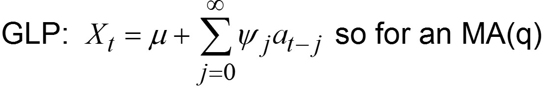


Represent the model as a GLP.
$$X_{t}=a_{t}−.8a_{t−1}+.5a_{t−2}$$
GLP Format
$$X_{t}=1+a_{t}+−.8a_{t−1}+5a_{t−2}$$
Notes:
X_{t} at time t is a linear combination of present and past noise components
An MA(q) is a finite GLP and is always stationary

Slide 5
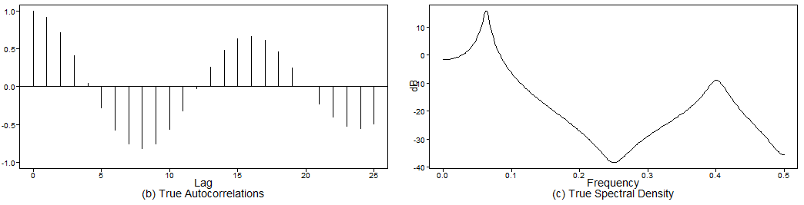
Generate a realizations from an ARMA model. You pick p and q. Include the ACF and spectral density.
#ARMA(4,3)
plotts.true.wge(250, phi = c(.3,.9,.1,-.8075), theta = c(-.9, -.8,-.72))
I chose to generate an ARMA(4,3).
I have included both the True Autocorrelation and the Spectral Density graphs.

Slide 6
Use AIC 5 to identify the top five quality models with respect to AIC for the cancelled flight data from the SWADelay.csv data set (column: arr_cancelled). Comment on which are AR, MA, and ARMA.
# Read in the data
SWA = read.csv("Data/swadelay.csv",header = TRUE)
plotts.wge(SWA$arr_cancelled)
plotts.sample.wge(SWA$arr_cancelled)
aic5.wge(SWA$arr_cancelled)
Five Smallest Values of aic
p q aic
4 1 0 7.371886
3 0 2 7.376428
7 2 0 7.381147
5 1 1 7.381147
2 0 1 7.386961
Here we have the top five quality models with respect to the AIC for the canceled flight data from the SWADelay.csv data set using the arr_cancelled column.
We can see that the top model with respect to the AIC will be an AR(1) model (7.371886). The second is an MA(2) with and AIC of 7.376428. Third will be and AR(2) model with a score of 7.381147. Forth is the only ARMA in the group; it is an ARMA(1,1) and scores a 7.381147. Finally there is an MA(1) that has an AIC of 7.386961.

Slide 7
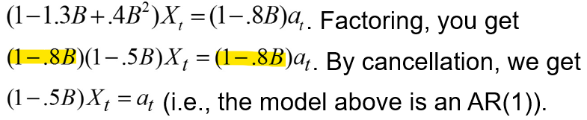
A brief reflection of thoughts and key takeaways – Week 5
Wording for AR models for which the characteristic equation has complex conjugate roots.
The data have a pseudo-cyclic appearance.
The autocorrelations show damped sinusoidal behavior.
The spectral density has a peak at some f₀ between 0 and .5 (at approximately .1 in this case).
Akaike’s Information Criterion
used to evaluate and compare the quality of models
the model with the lowest AIC is thought to have the most quality
Cancellation
ψ-Weights are used in establishing prediction limits on forecasts
calculate ψ-weights using tswge command
psi.weights.wge
ϕ(B)X_{t} = θ(B)a_{t} is a stationary and invertible ARMA(p,q) process iff:
Roots of ϕ(z) = 0 are all outside the unit circle
Roots of θ(z) = 0 are all outside the unit circle
Note: In order to refer to a process as “ARMA,” we will require it to be stationary and invertible.
An MA(q) is an ARMA(0,q) model.
An AR(p) is an ARMA(p,0) model.
Question:
I am still having problems visualizing Invertibility. I found this information: http://www-stat.wharton.upenn.edu/~stine/stat910/lectures/08_intro_arma.pdf Conditions for invertible ARMA Assume that the polynomials φ(B) and θ(B) have no common zeros. The process {Xt} is invertible if and only if the zeros of the moving average polynomial θ(B) lie outside the unit circle.
Would you please explain in more detail Invertibility in regards to 3.2.12 in the book and will the factor tables always look the same if it this condition is met?

